Slide 1

Basic Details of the Team and Problem Statement
Ministry/Organization Name/Student Innovation: Government of Gujarat
PS Code: SIH1364
Problem Statement Title: Fake social media profile detection and reporting
Team Name: GenesisVR
Team Leader Name: Varun Dronamraju
Institute Code (AISHE): U-0011
Institute Name: Gandhi Institute of Technology & Management ( (GITAM) University, Visakhapatnam
Theme Name:Blockchain & Cybersecurity

Slide 2
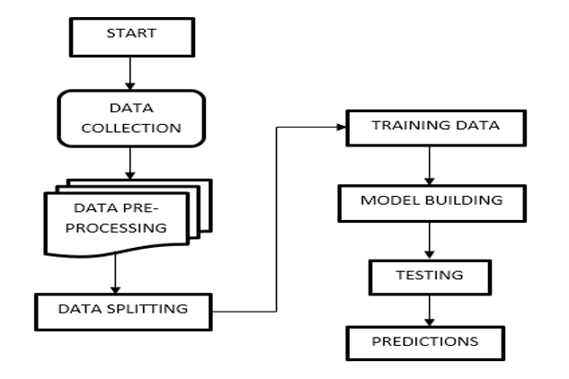
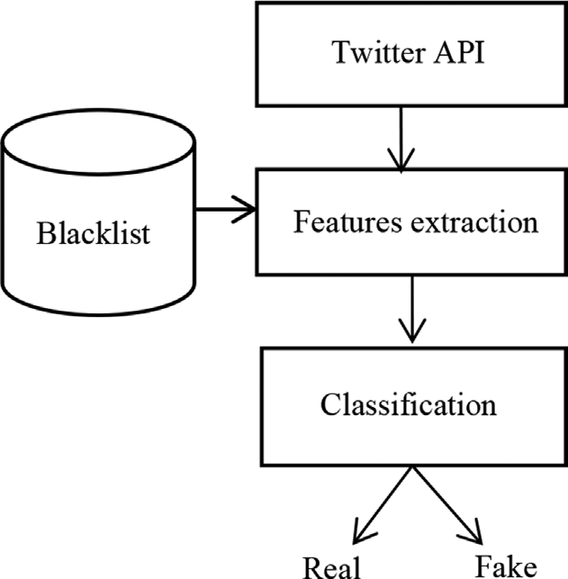
Idea/Approach Details
Describe your idea/Solution/Prototype here:
Our project aims to develop a comprehensive system leveraging advanced detection algorithms , user education, and improved reporting mechanisms to combat the proliferation of fake social media accounts.
With the help of machine leaning models such as random forest, SVM, MLP we have developed an algorithm that can identify fake social media accounts.
We have implemented three different machine learning models so that our program can accurately analyze data sets of different sizes.
Random Forest - Small to Large Datasets.
Support Vector Machine (SVM) - Small to Medium Datasets.
This approach helps us create a robust software which can give an accurate score regardless of the size of the dataset.
Add process flow chart or simulated image of prototype or any relevant image related to your idea
Describe your Technology stack here:
Programming Languages: Python: Python.
Data Collection: Twitter API: Use Tweepy for Twitter data collection. Facebook Graph API: For Facebook data collection. Instagram Graph API: For Instagram data collection.
Data Storage: MongoDB or PostgreSQL
Web Scraping (Optional): BeautifulSoup or Scrapy
Data Preprocessing: Pandas
Database Management: SQLAlchemy (for PostgreSQL) or PyMongo (for MongoDB)
2

Slide 3
Idea/Approach Details
Describe your Use Cases here
Describe your Dependencies / Show stopper here
Our primary users are Crime branch and other investigative agencies.
The user will enter the username that he/she would want to check if that account is fake or not
Our algorithm analyses the account and checks a certain number of parameters such as followers, following, likes , tweets count etc.
It will generate a score based on the analysis (example: this account is 97% fake) and the user will be provided with an option to report the account if needed.
We have developed an algorithm which uses three different AI models each for a specific size of dataset to analyze and spot fake accounts
We use ai models for the core function of our programs.
We require API’s of different social media platforms.
We also require database storage systems to store large amounts of data.
Availability of a diverse and up-to-date dataset for training the machine learning model.
Our algorithm can asses accounts which are present in the current database, any new entries which are not updated will not be abled to be analyzed.
Legal and ethical considerations regarding user privacy and data usage must be addressed, potentially requiring compliance with GDPR and other regulations.

Slide 4
Team Member Details
Team Leader Name:Varun dronamraju
Branch (Btech/Mtech/PhD etc): Btech | Stream (ECE, CSE etc):CSE | Year (I,II,III,IV):3rd year
Team Member 1 Name: Mavulate Dileep Ramprasad Branch (Btech/Mtech/PhD etc):Btech | Stream (ECE, CSE etc):CSE | Year (I,II,III,IV):3rd year
Team Member 2 Name:Gudivada Yash Sri Raj Branch (Btech/Mtech/PhD etc):Btech | Stream (ECE, CSE etc):CSE | Year (I,II,III,IV):3rd year
Team Member 3 Name:Akkilam Aiswarya Lakshmi
Branch (Btech/Mtech/PhD etc):Btech Team Member 4 Name:PVSS PRAMODH | Stream (ECE, CSE etc):CSE | Year (I,II,III,IV):2nd year
Branch (Btech/Mtech/PhD etc):Btech | Stream (ECE, CSE etc):CSE | Year (I,II,III,IV):2nd year
Team Member 5 Name:Aaron Indana Branch (Btech/Mtech/PhD etc):Btech | Stream (ECE, CSE etc):CSE | Year (I,II,III,IV):1st year
Team Mentor 1 Name:Dr. Nitalaksheswara Rao K Category (Academic/Industry):Academic | Expertise (AI/ML/Blockchain etc):AI | Domain Experience (in years):8 years
Team Mentor 2 Name: Dr.P.Sankara Rao
Category (Academic/Industry): Academic | Expertise (AI/ML/Blockchain etc): ML, IOT | Domain Experience (in years):20 years

